Slide 1


Project On: Adventure Works Cycles
Date:
13 Nov 2022
Team Members:
Ajay Anap
Pranav Singh
Suhas Malaji
Monika Sonawane
Hrutuja Mohangekar
Shubham Dhavan

Slide 2
Project Objective
This Adventure works cycle company is Multinational company which manufactures and sells metals to North America, European & Commercial markets. So, we create KPI’s, Dashboards to visualize the sales of company which is compatible for customers and so the company can expand their business.
i) Excel- Data cleaning, Pivot Table, use various functions like Vlookup, Filters.
ii) My SQL- Perform queries with syntax like Joins, Primary key, Alter table etc.
iii)Tableau & Power Bi- Perform visualizations to showcase the KPI’s in the form of Dashboard.

Slide 3
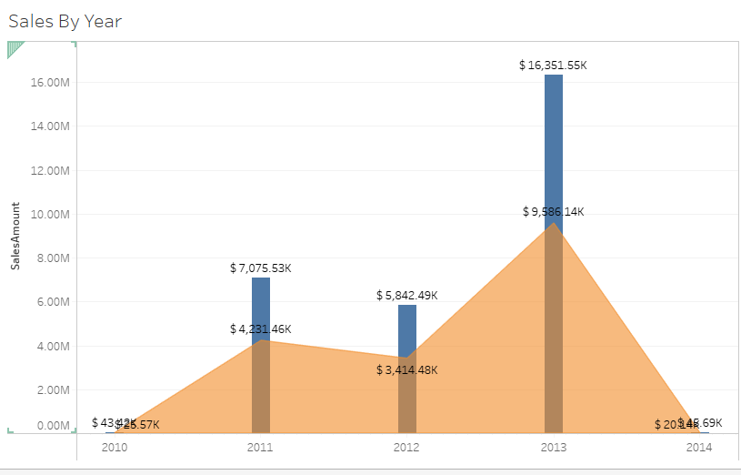
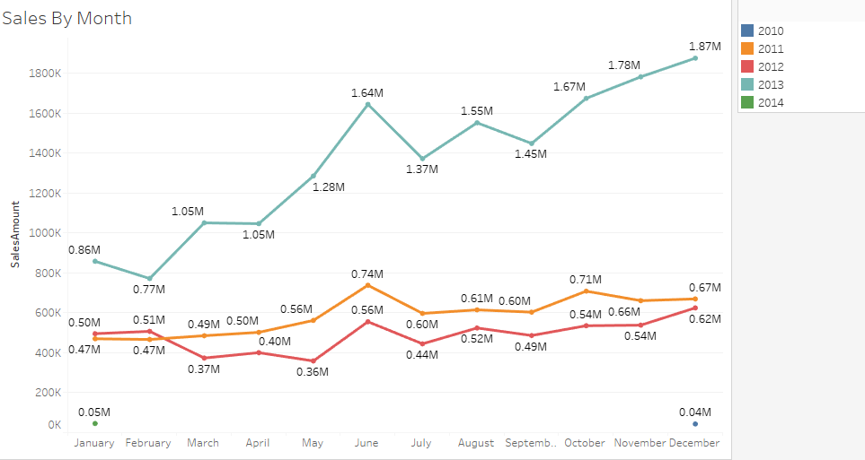
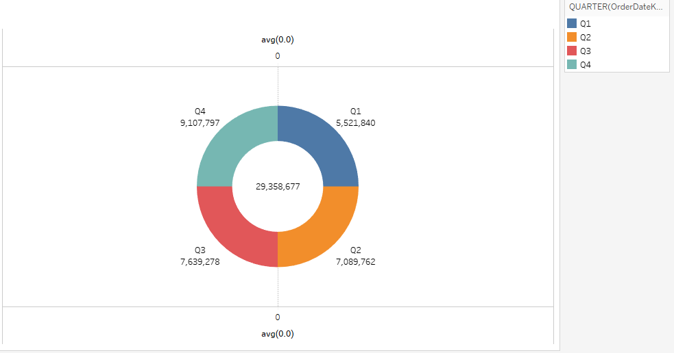
KPI’s
In Fig 1 as we created combinational chart of Bar Chart & Area Chart, so it shows the highest sale is $16351.55K in 2013 with Total Product Cost of $9586.14K & Lowest sale is $43.42K in 2010 with Total Product Cost of $20.14K in 2014.
In Fig 2 as we created Line Chart it shows the Highest sale is in year 2010 is in June which is 1.64M & Lowest sale is in year 2012 is in May which is 0.36M.
In Fig 3 as we created Pie chart, we can see the highest sale is in Quarter 4 which is $91,07,797.
Fig 1
Fig 2
Fig 3

Slide 4
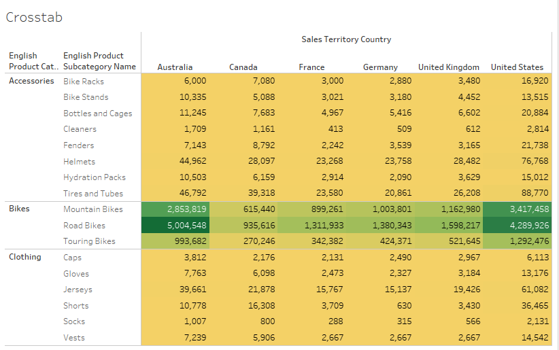
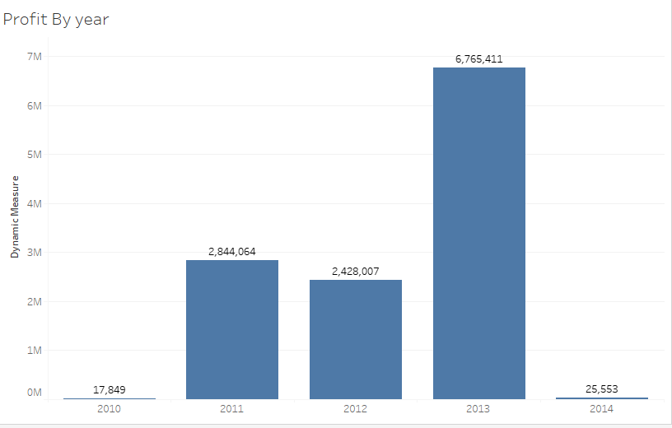
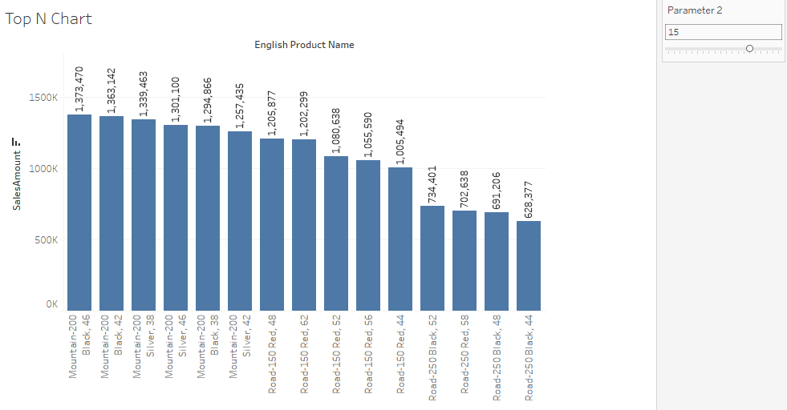
KPI’s
In Fig 4 as we created Highlighted Table we use two colours that are Green and Gold which indicates the sales by categories and as in chart the Bikes category has Highest amount of Sales so it highlighted as in Green colour.
In Fig 5 as we shown Profit by year in Bar chart is shoes highest profit is in year 2013 which is $67,65,411 & lowest profit is in year 2010 which is $17,849.
In Fig 6 we shows Top 15 sales amount by English Product Name so the highest one is Mountain-200 Black,46 which has sales amount of $13,73,470.
Fig 4
Fig 5
Fig 6

Slide 5
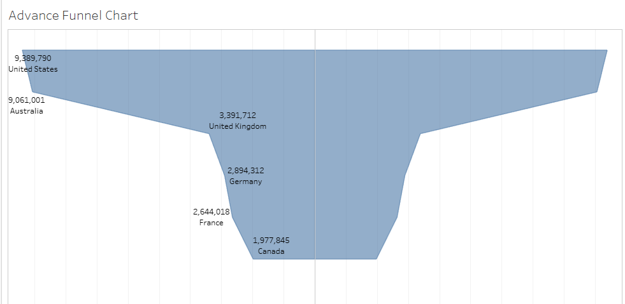
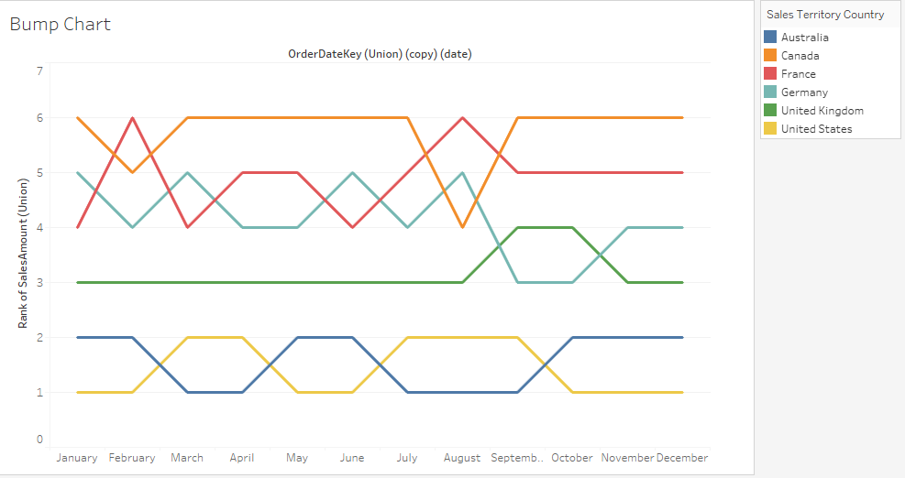
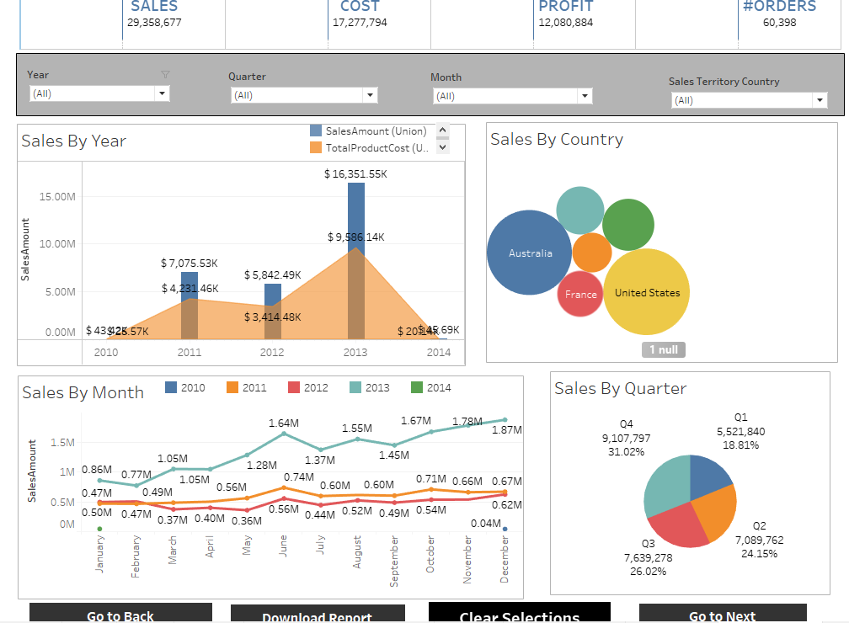
KPI’s
In Fig 7 as we created Advance Funnel Chart it shows United States has highest amount of sales which is $93,89,790 & Canada has Lowest sales amount which is $19,77,845.
In Fig 8 as we created Bump Chart which shows the Ranking of Countries by sales amount and United States ranked 1 & Canada ranked 6.
Fig 9 shows the Dashboard which has filters Year-wise, Month-wise, Quarter-wise & Country-wise so accordingly we get the results.
Fig 7
Fig 8
Fig 9

Slide 6
Thank You

